Slide 1
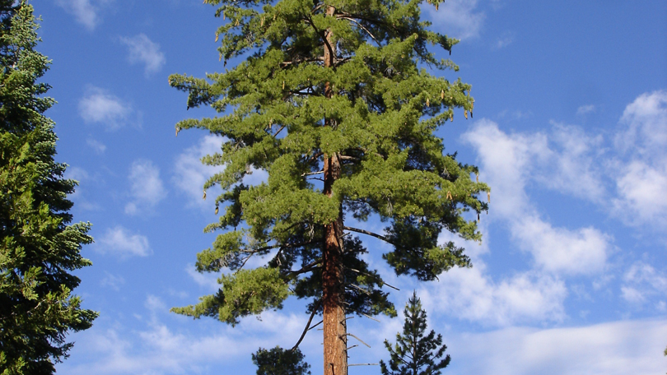
Sugar Pine
Demographic Status, Trajectories, and Stressors

Slide 2
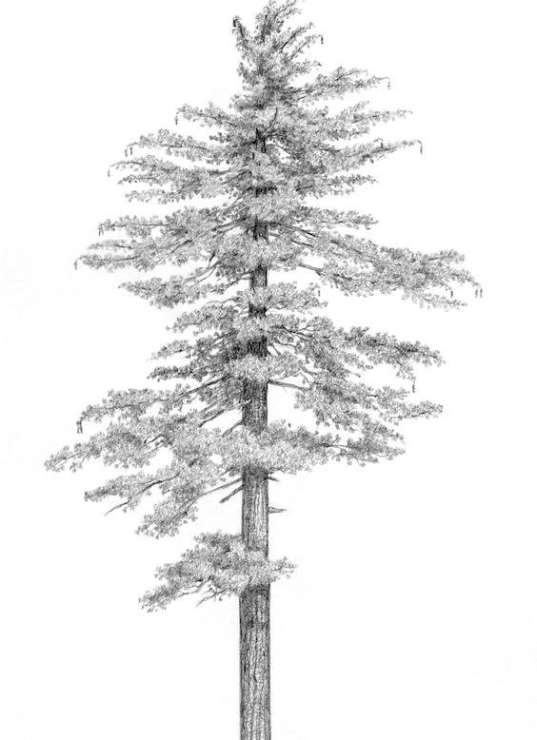
Pinus lambertiana (sugar pine)
5-25% of basal area in the mixed conifer forest type in CA and OR
Valuable food source for wildlife
The largest member of Pinus, the “Queen of the Sierra”
Facing numerous threats
Matt Strieby

Slide 3
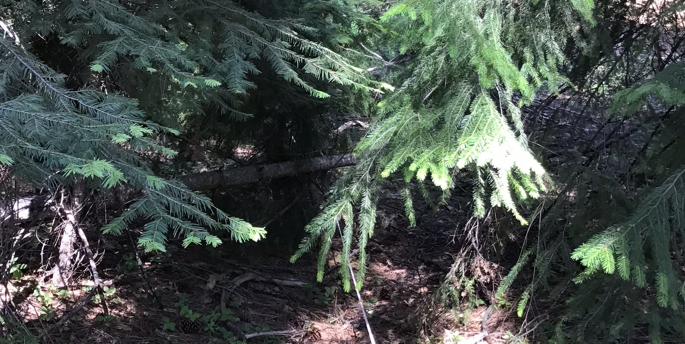
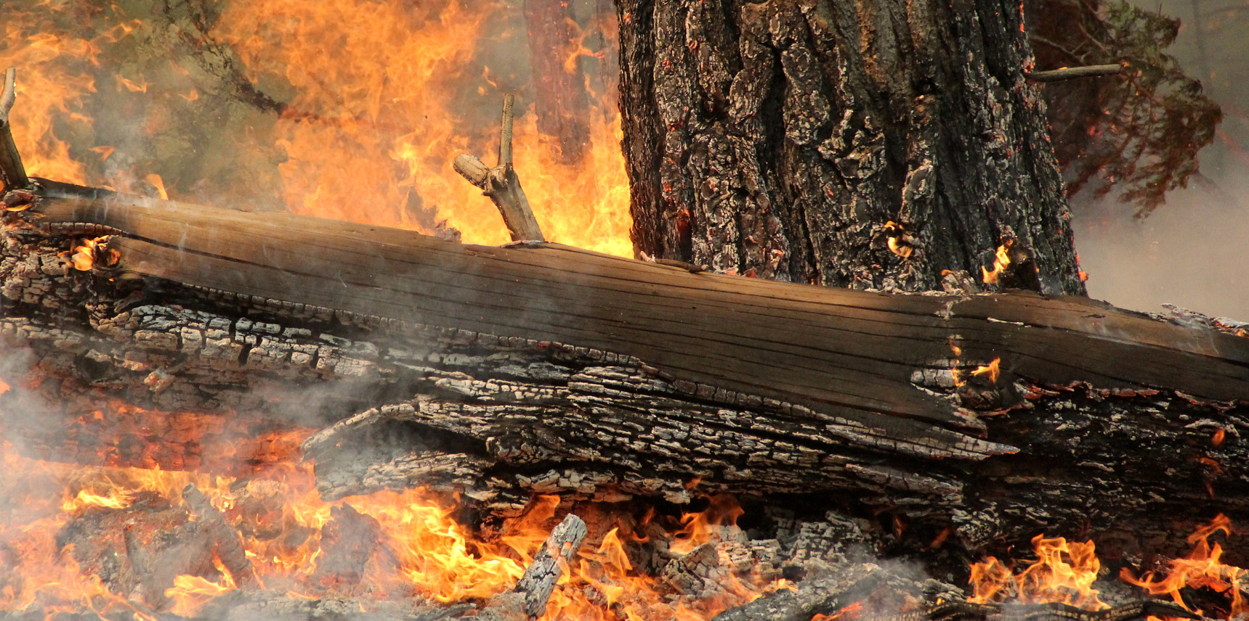
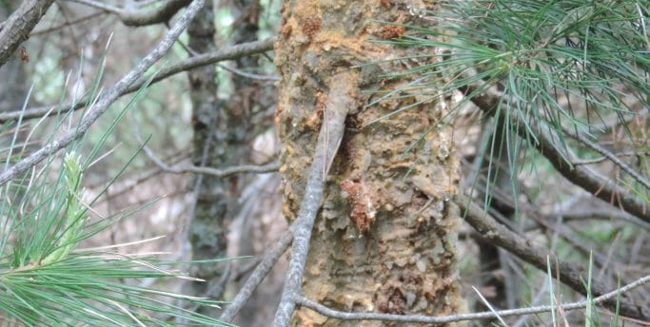
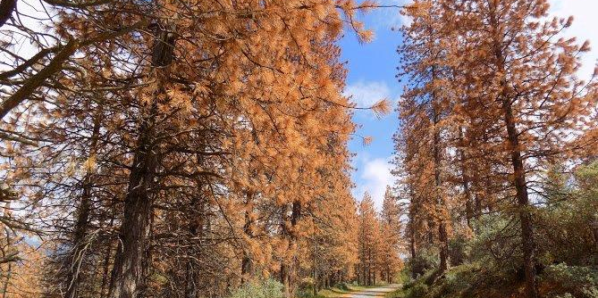
Stressors
Densification
Fire
Hudson Northrup
USFS Region 5
Drought + bark beetles
White pine blister rust
Sugar Pine Foundation
USFS Region 5

Slide 4
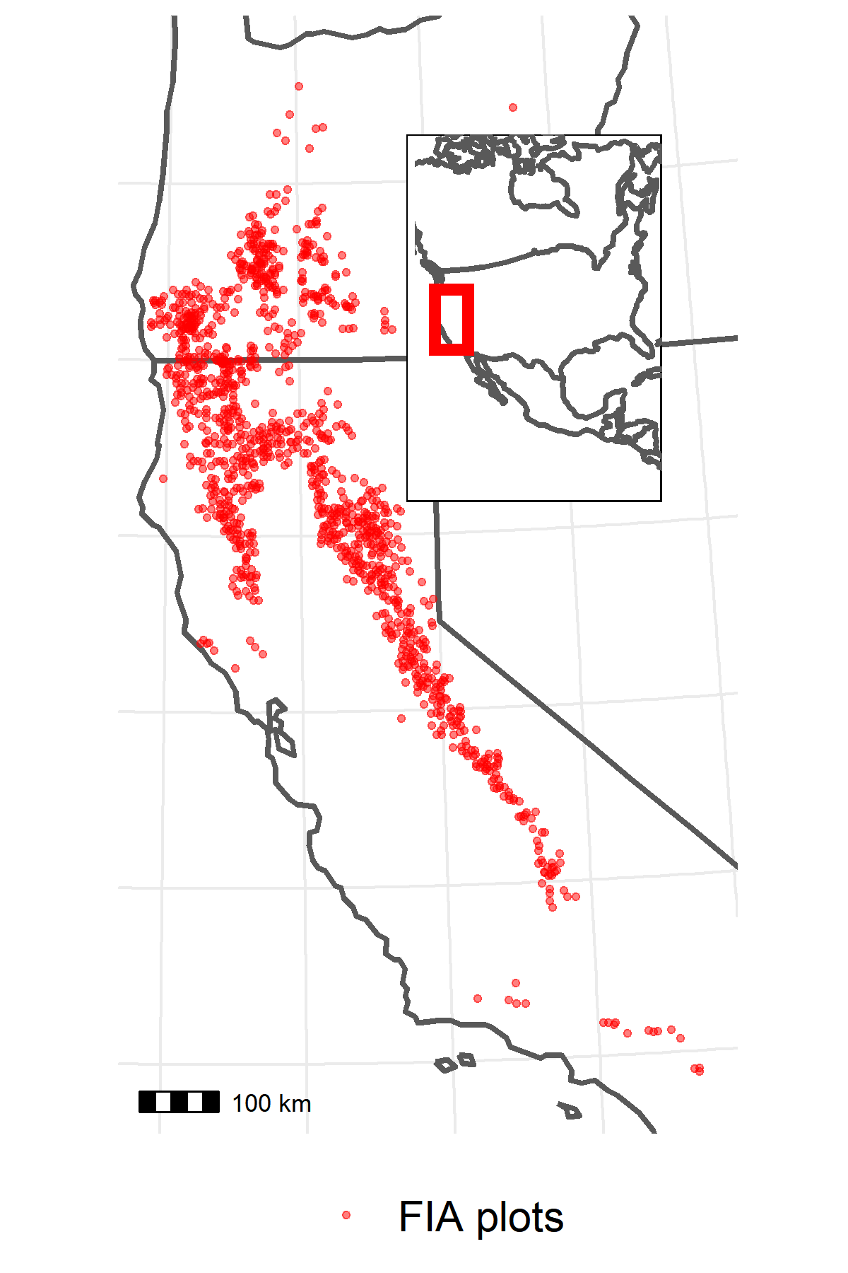
Data
1,221 US Forest Service Forest Inventory and Analysis (FIA) plots
1/10th of plots visited every year since 2001
~10 years between visits, 2 visits per plot
On each plot:
Inventory stems > 2.54 cm DBH
Presence of disturbances (e.g., fire)
Climatic water deficit (CWD) data from TerraClimate

Slide 5
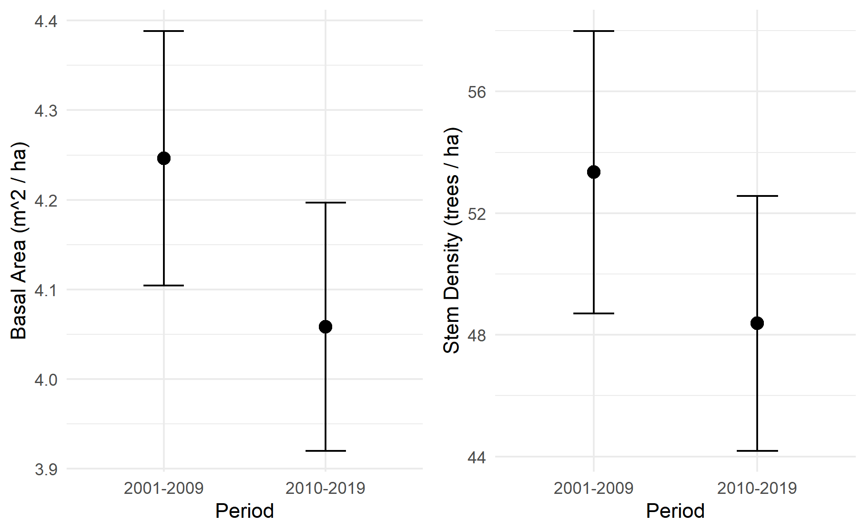
Observed declines in abundance

Slide 6
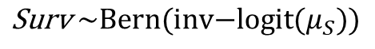
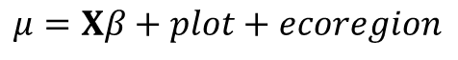
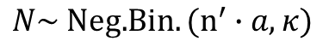
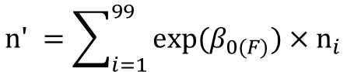
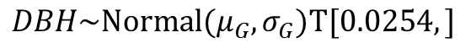
Explanatory variables
Vital rate functions
Survival
Integral projection model
Fire
WPBR
Basal area
Drought
Site dryness
Growth
Fecundity
Size-class transition matrix
Asymptotic population growth rate
Interactions with DBH
DBH
Single-step population projection
$$\text{S}\text{urv} \sim \text{Bern}\text{(}\text{inv}\text{−}\text{logit}(μ_{S}))$$
$$DBH\sim \text{Normal}\text{(}μ_{G}, σ_{G})T[0.0254,]$$
$$\text{n}\text{' }=\sum_{i=1}^{99}{\text{exp}\text{(}β_{0(F)}\text{)}}×{\text{n}}_{i}$$
$$μ=Xβ+plot+ecoregion$$
$$N\sim \text{N}\text{eg}\text{.}Bin.(n^{′}∙a, κ)$$

Slide 7
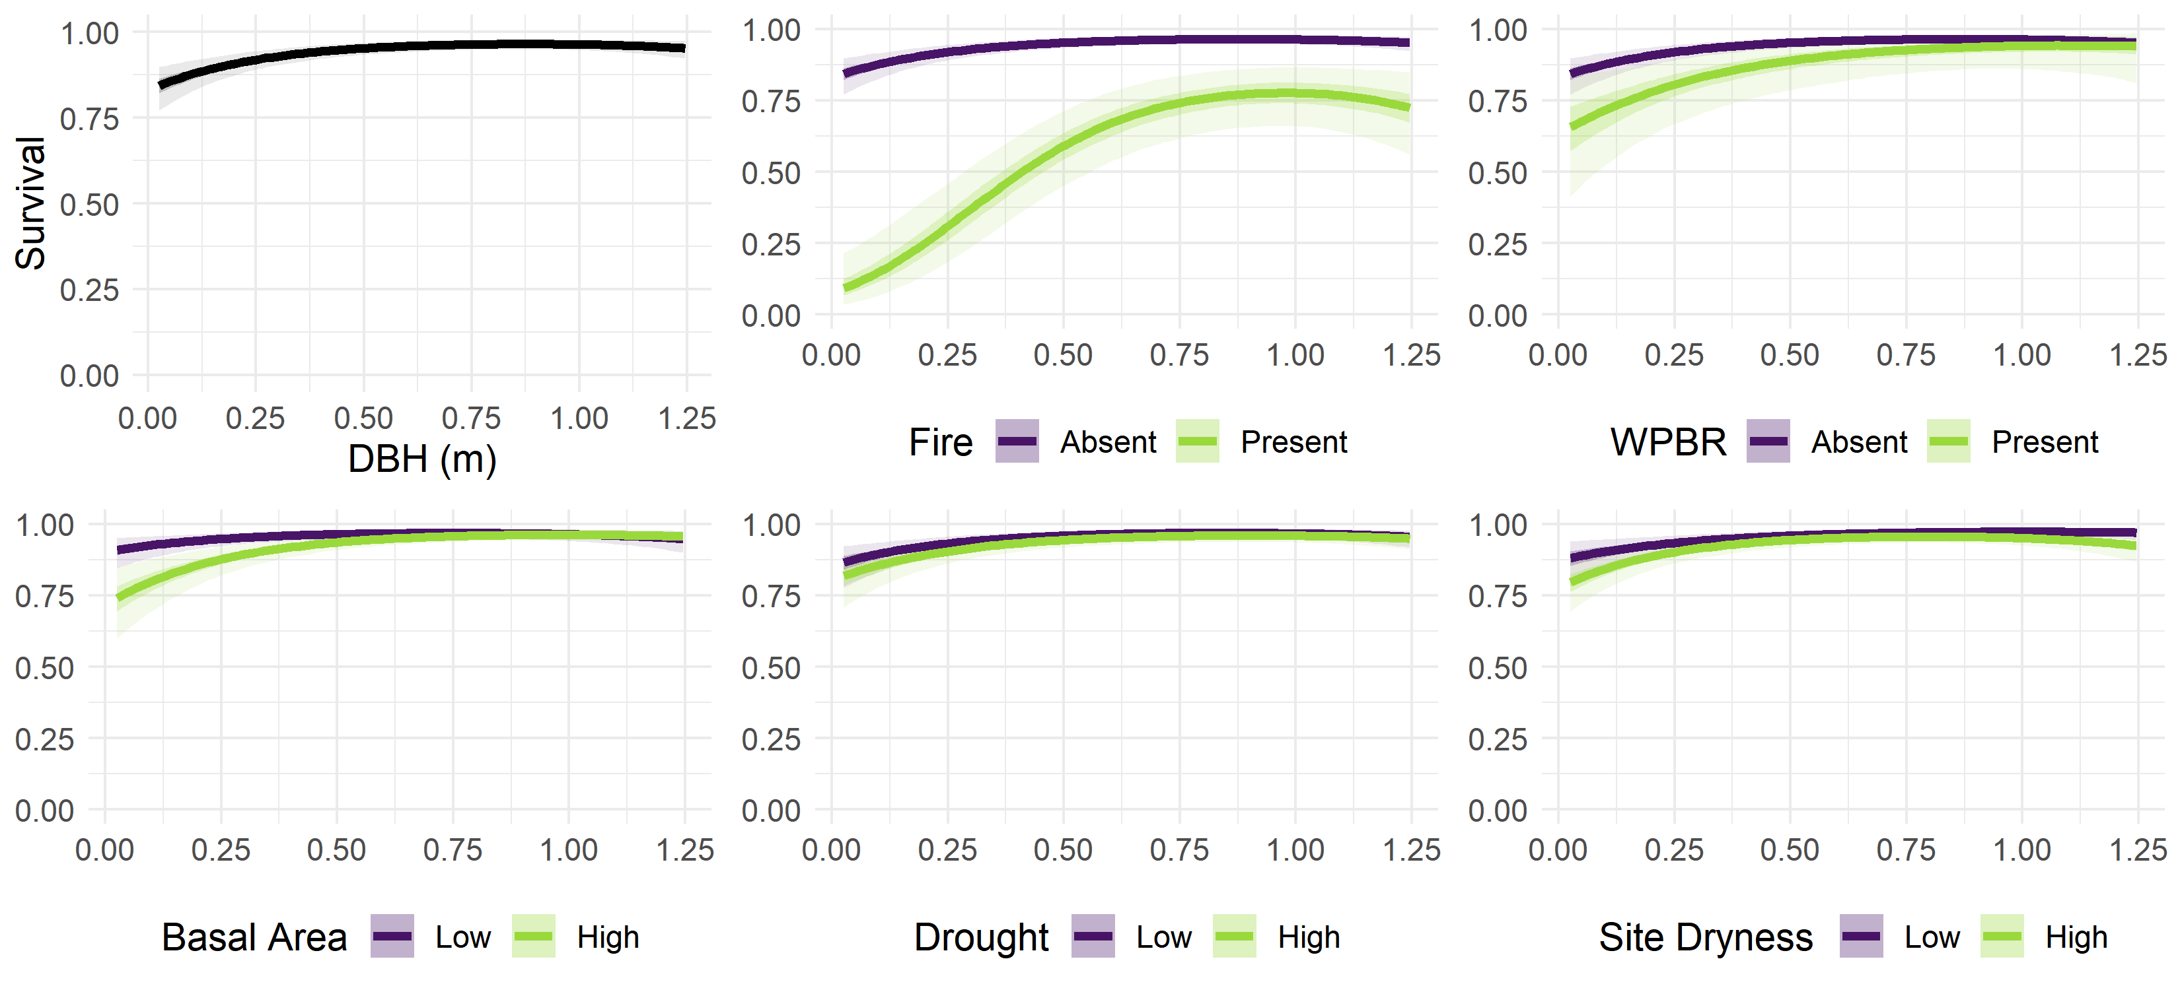

Slide 9
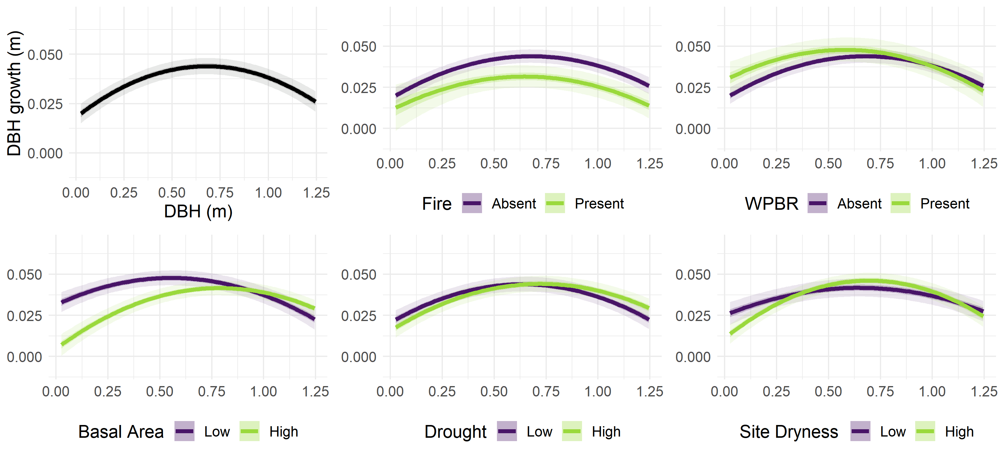

Slide 11
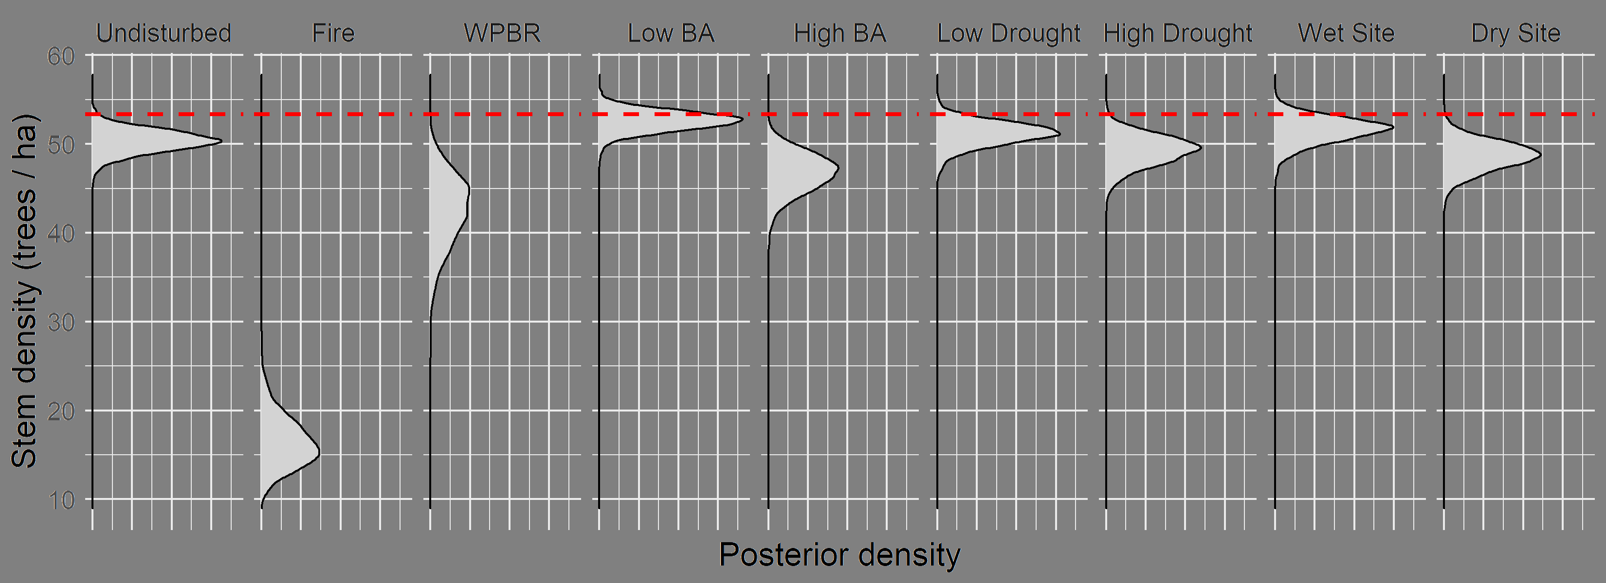
Projected population size (after 10 years)

Slide 12
Projected population size (after 10 years)

Slide 13
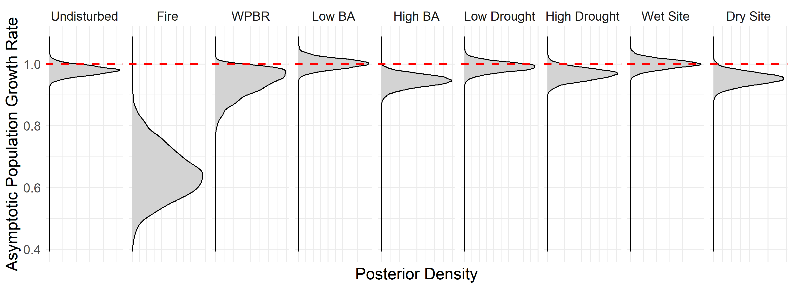
Asymptotic population growth rate

Slide 14
Asymptotic population growth rate

Slide 15
Takeaways
Observed population trend is negative
Fire is a severe stressor
Population predicted to decline both immediately and long term under most scenarios
Conservation should address fire risk, density, and WPBR: tractable challenges
More data is needed to understand fecundity

Slide 16
Thanks

